Slide 1
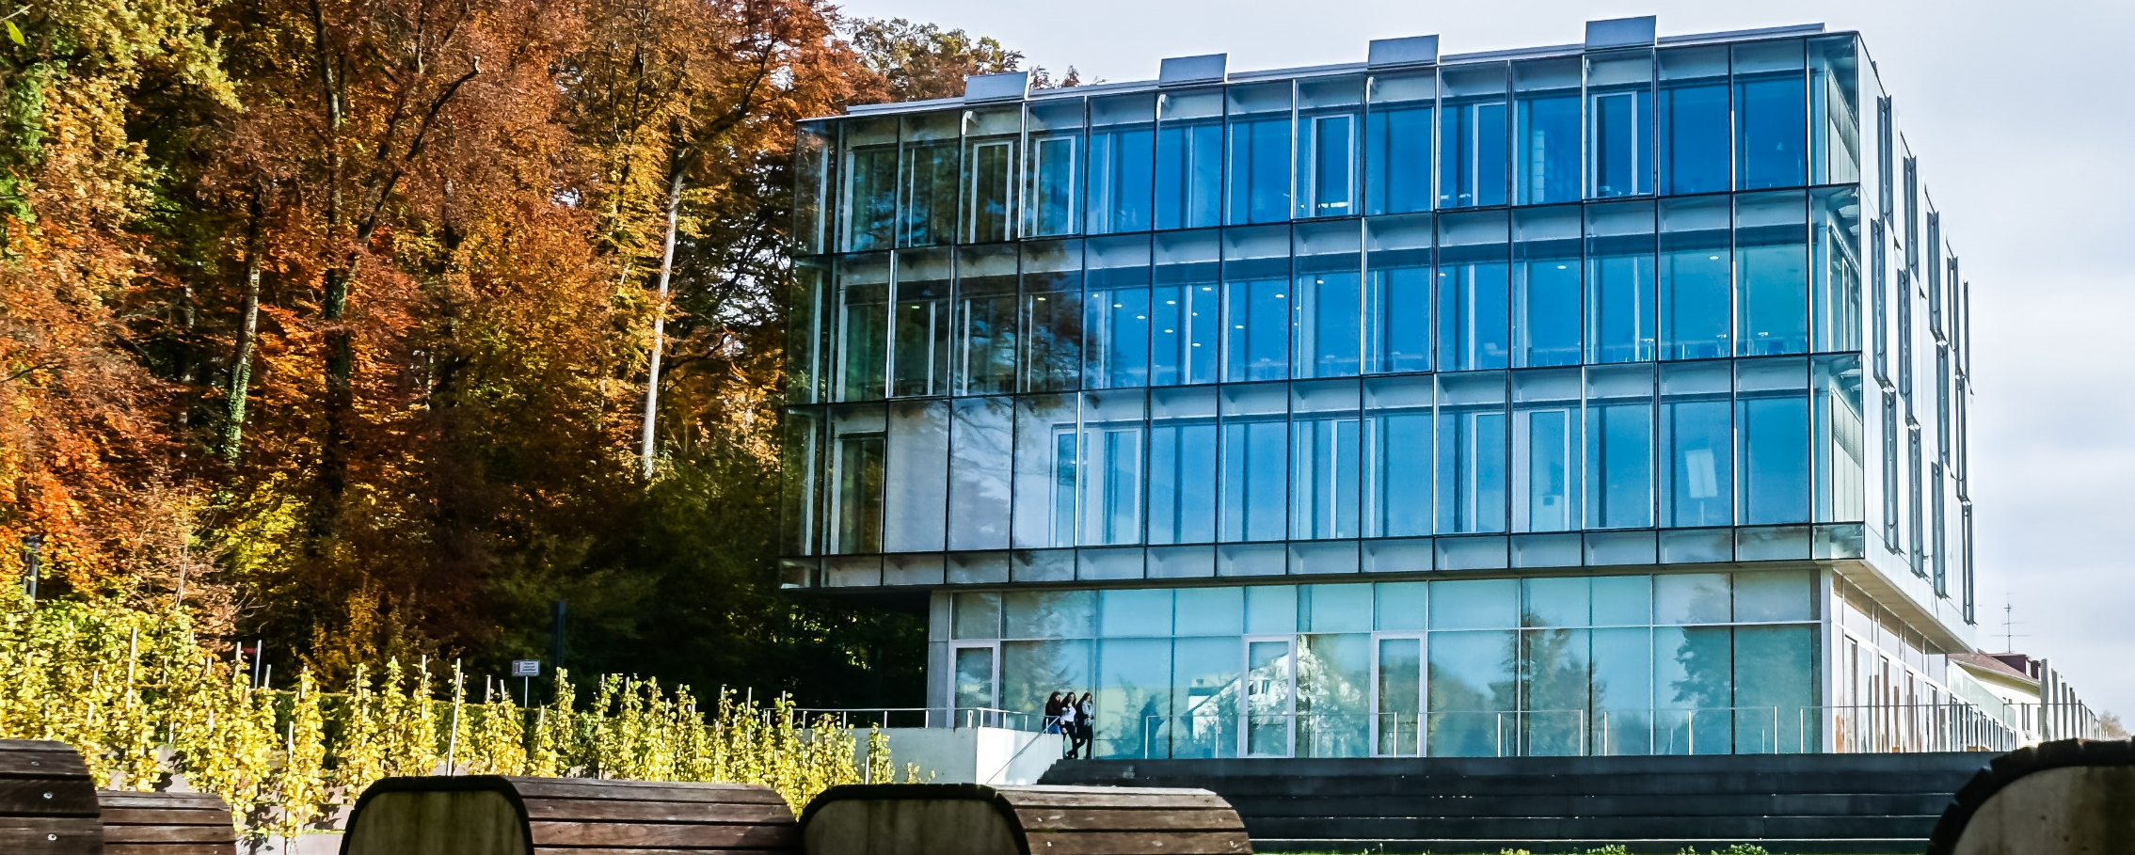
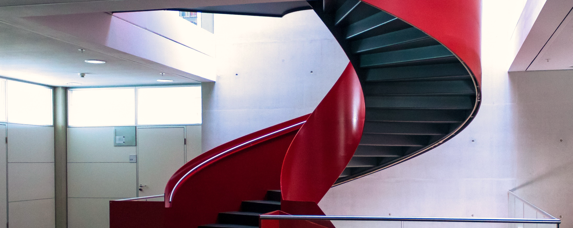
Zeppelin university
Master of Science in Management – Advancing sustainable change

Slide 2
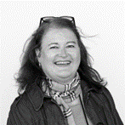
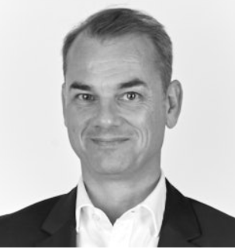
Part-time Master Program M.SC. In Management
Welcome and introduction - Meet the team
Heike Viellieber
Prof. Dr. Christian Opitz
ZU Executive Education
Program Management
T +49 7541 6009 1606
heike.viellieber@zu.de
Academic Program Chair MSc MGMT
Chair of Corporate Management & Human Resource Management
T +49 7541 6009 1251
christian.opitz@zu.de
Notes:
Melanie Sassmann

Slide 3
Part-time Master Program M.SC. In Management
Get to know
Key objectives and structure of the part-time Master Program
What can you achieve and expect when studying with us?
Zeppelin University in Friedrichshafen
A great place for your studies - student life at the lake and abroad
Even more – what is important for you to come and join us? Question & Answer Session!
Notes:
Melanie Sassmann

Slide 4
Key objectives and structure of the part-time Master Program

Slide 5
Part-time Master Program M.SC. In Management
Advancing sustainable change
The Master of Science in Management (MSc MGMT) is a general management program that combines business administration with elements from other disciplines, including psychology, sociology, and practical philosophy.
By drawing on different theoretical perspectives, state of the art research results, and advanced scientific methods students are qualified to design and implement innovative solutions for the complex business challenges of the 21st century.
Within a holistic learning approach – based on interactive lectures, seminars, and projects – students are required to work on interdisciplinary and cross-disciplinary topics, while being integrated in a diverse team of fellow students.
The small group-setting and one-week learning units further supports the students to find, translate and combine information outside their own area of expertise, including knowledge from the field.
Professional experience is a key element of the learning process. Students systematically reflect on their practical experiences in light of academic theories and frameworks.
Notes:
Christian Opitz

Slide 6
The overall goal of the program is to enable students to act and behave as “sustainable change agents” providing a valuable contribution to the transformation of their organizations, in an individually and socially responsible manner.
Notes:
Christian Opitz

Slide 7
Part-time Master Program M. SC. In Management
Structure and modules
The curriculum is structured around three central themes
Responsible & Sustainable Management
Students gain in-depth knowledge of strategic management, orgnizational design, human resource management, and responsible leadership, enabling them to guide organisations toward long-term success
Digital Transformation & Data-Driven Decision Making
The program develops competencies in digital technologies and data analytics, empowering students to support strategic decision-making and design innovative business models in dynamic markets
Human-Centered Organizational Change
Students explore the human and organizational dimensions of transformation by integrating change management, diversity, innovation management, and organizationalpsychology
Core Modules (44 CP)
Strategic Management (4 CP)
Organization and HR Management (4 CP)
Financial Decision-Making & Performance Control (4 CP)
Data Analysis & Econometrics (4 CP)
Digital Transformation and Entrepreneurship (4 CP)
Entrepreneurial Finance and Corporate Venturing (4 CP)
Industrial & Organizational Psychology (4 CP)
Consumer Behavior and Employer Branding (4 CP)
Diversity- and Innovation Management (4 CP)
Digital Transformation and Change Management (4 CP)
Responsible Leadership and Interpersonal Skills (4 CP)
International Academy, South Africa (6 CP)
International- & Intercultural Management (6 CP)
Project Work (10 CP)
Applied Data Science (10 CP)
MA-Thesis (30 CP)
Notes:
Christian Opitz

Slide 8

Part-time Master Program M.SC. In Management
Learning outcomes
Learn how to tackle new problems and start own initiatives
Understand the impact of digitalization on modern markets and the “triple bottom line” of a business
Develop an entrepreneurial mindset and identify new (digital) business opportunities
Become acquainted with managing and analyzing big data to draw insights
Value diversity and inclusion as a source for long-term prosperity
Refine communicative skills and develop intercultural competencies
Define own ethical values and discuss impact on future decision making
Notes:
Christian Opitz

Slide 9

Part-time Master Program M. SC. In Management
Whom we are looking for
You will benefit the most from this program, if you are
Creative: You are fascinated by developing new ideas and solving challenging problems
Curious: You are eager to understand theoretical backgrounds and learn different perspectives and viewpoints
Caring: You consider consequences on the planet, society, and long-term prospects
Committed: You are willing to work hard and seek a decision-making position
Notes:
Christian Opitz

Slide 10

Part-time Master Program M. SC. In Management
Entry requirements
A bachelor’s degree of at least 180 CP and a minimum work experience of 1 year; individual exceptions may apply
Official application to the program
Interview with Prof. Dr. Opitz
English exam (test)
Notes:
Heike Viellieber

Slide 11
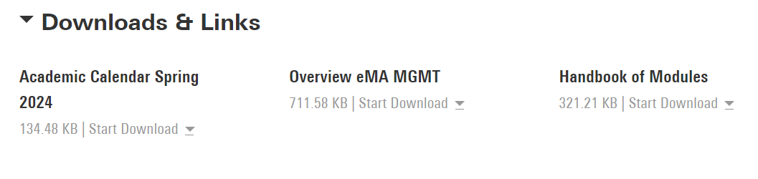
Part-time Master Program M. SC. In Management
Further information and next steps
Please find the academic calendar and details on the program on our website
Notes:
Heike Viellieber

Slide 12
What can you achieve and expect when studying with us

Slide 13
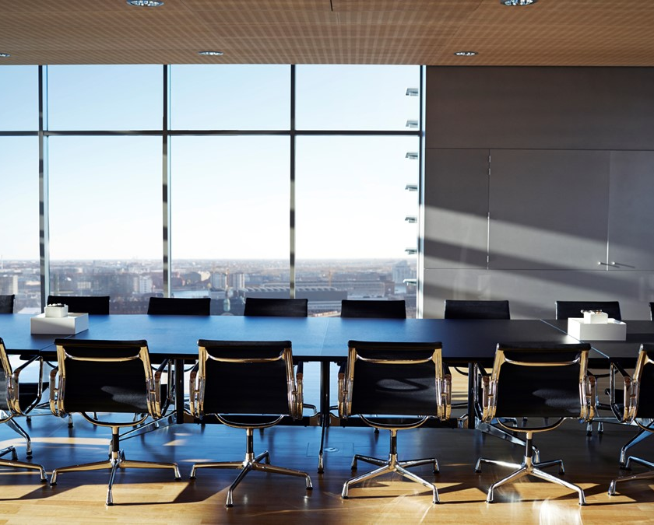
Part-time Master Program M. SC. In Management
Career impact
Graduates of the MSc MGMT are prepared to take on leadership roles in a wide range of fields, including:
Transformation and innovation management
Project and program leadership
Organizational development
Strategy and consulting
Entrepreneurship and start-ups
You will graduate with a powerful combination of analytical expertise, leadership capability, and a strong sense of responsibility – positioning you to make a meaningful difference in your organization and beyond.
Notes:
Melanie Sassmann

Slide 14
Zeppelin University in Friedrichshafen

Slide 15
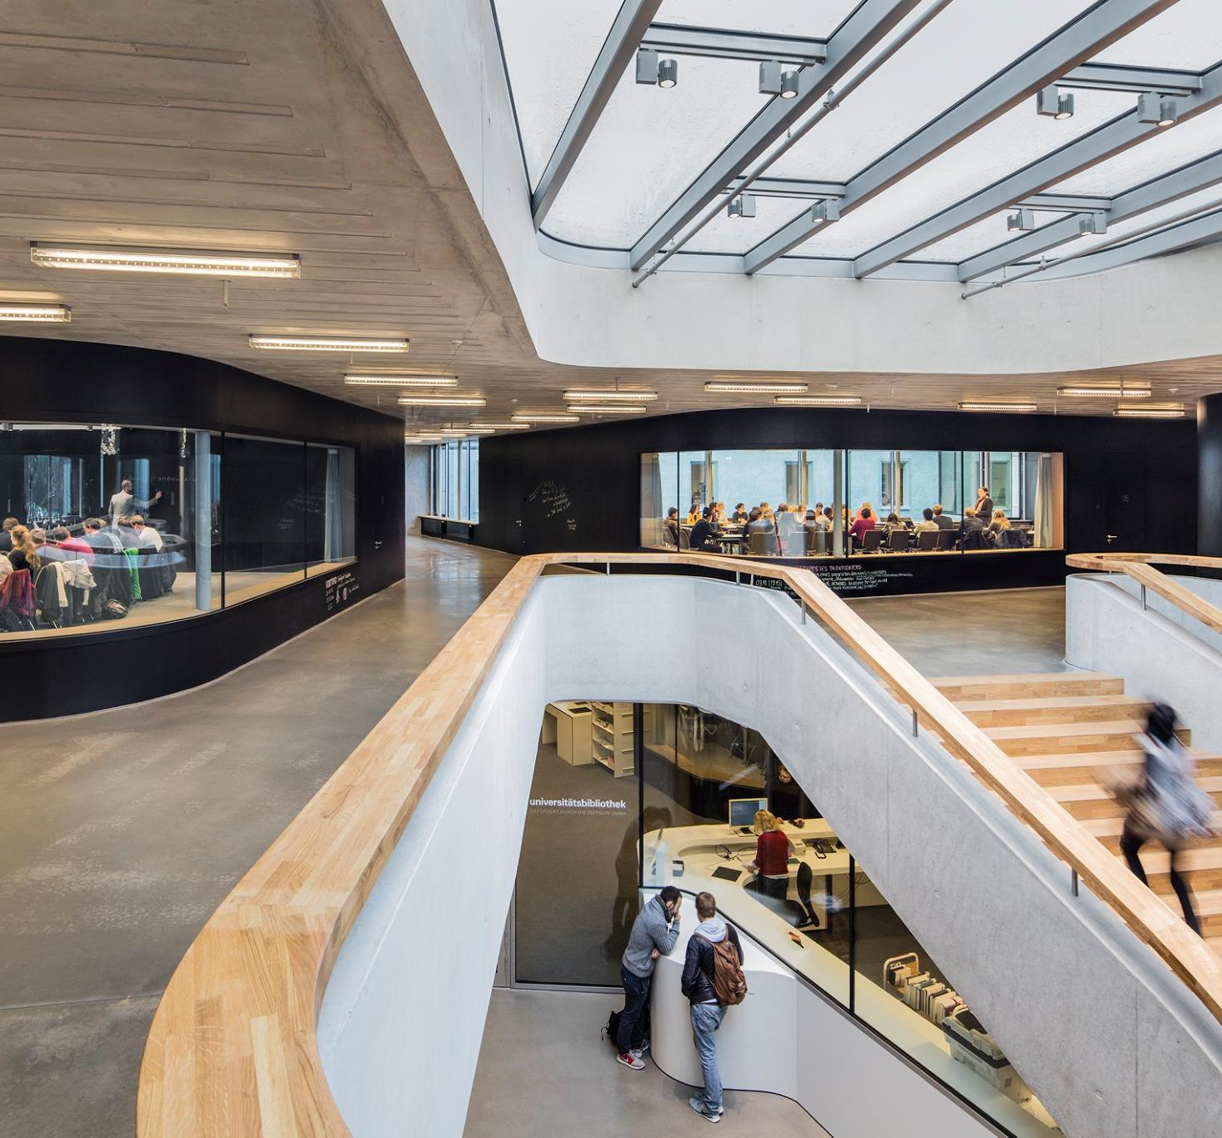


Slide 16
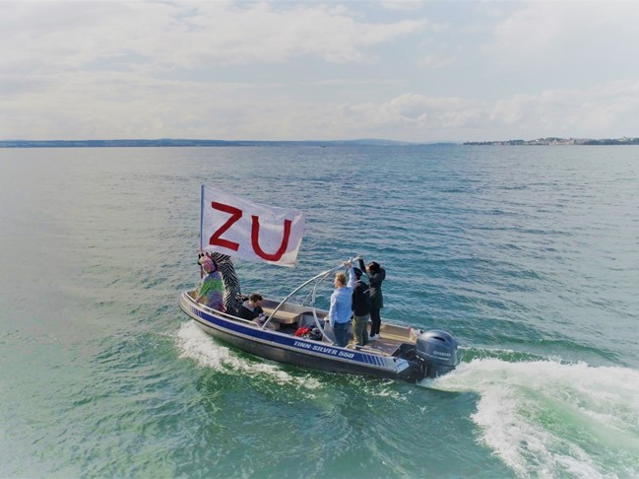
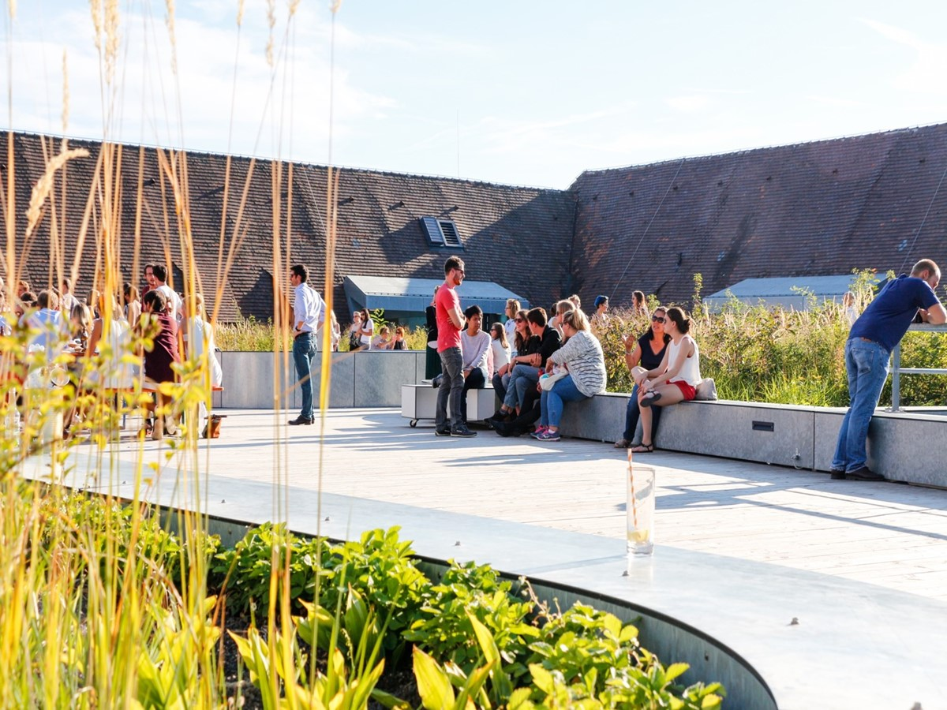
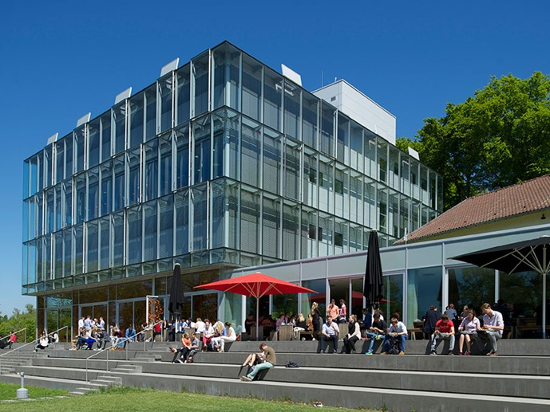

Part-time Master Program M. SC. In Management
Zeppelin university at a glance
Founded in 2003
As a state-recognized university under private sponsorship, we teach and research between the scientific disciplines of business, culture and politics; consistently interdisciplinary, individualized and international.
Our aim is to contribute to resolving society’s most pressing future issues.
Zeppelin University sees itself as driver of educational innovation.
Our values: openness and respect, trust and cooperation, curiosity and the joy of experimentation, commitment and aspiration
Notes:
Melanie Sassmann

Slide 17
A great place for your studies - student life at the lake and abroad

Slide 18
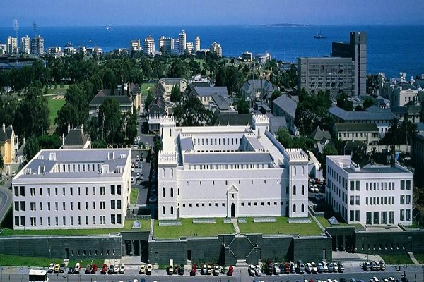
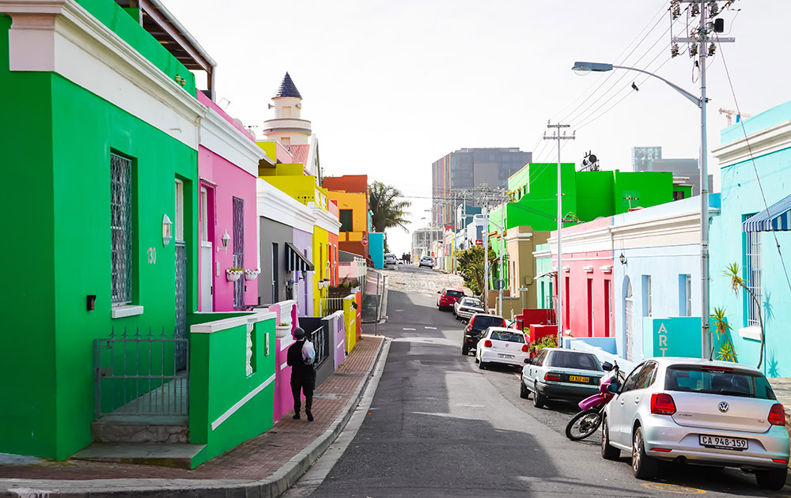
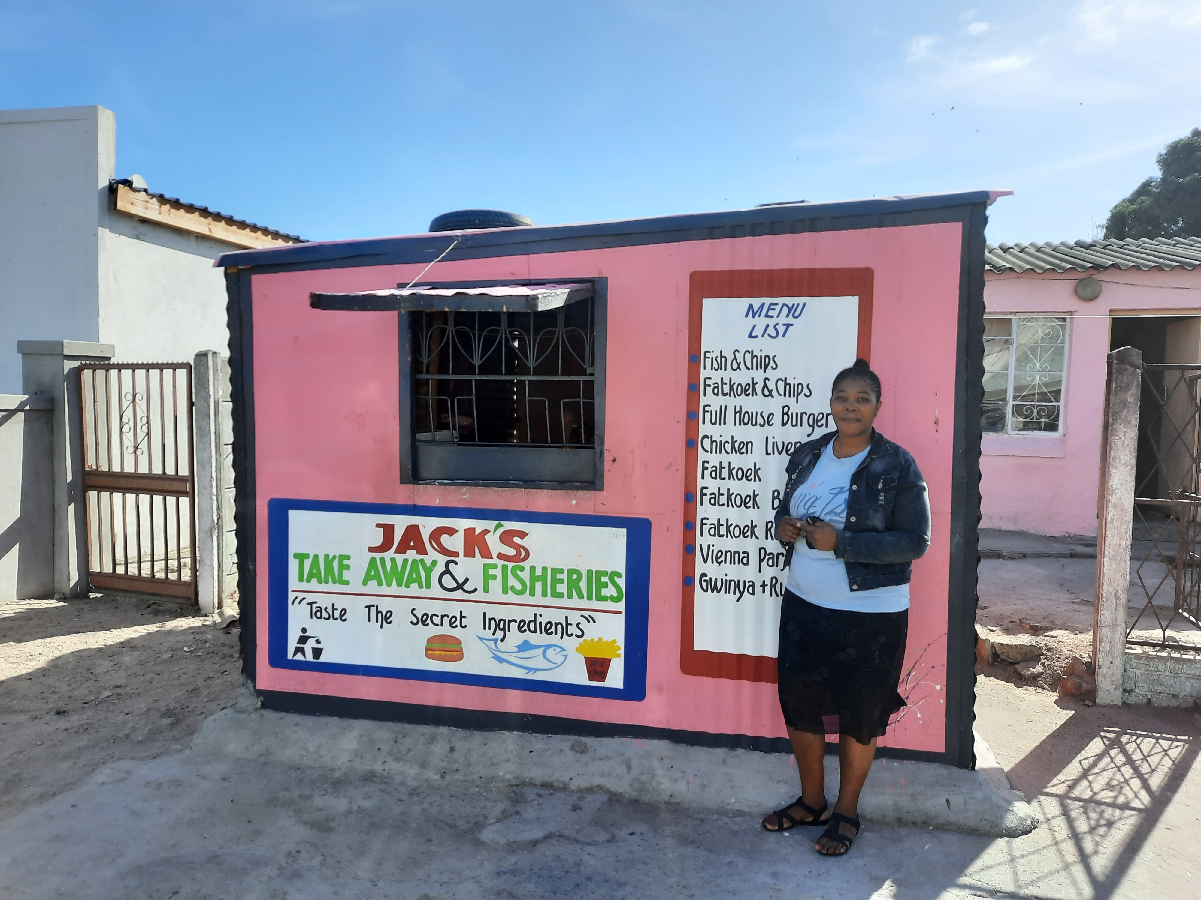
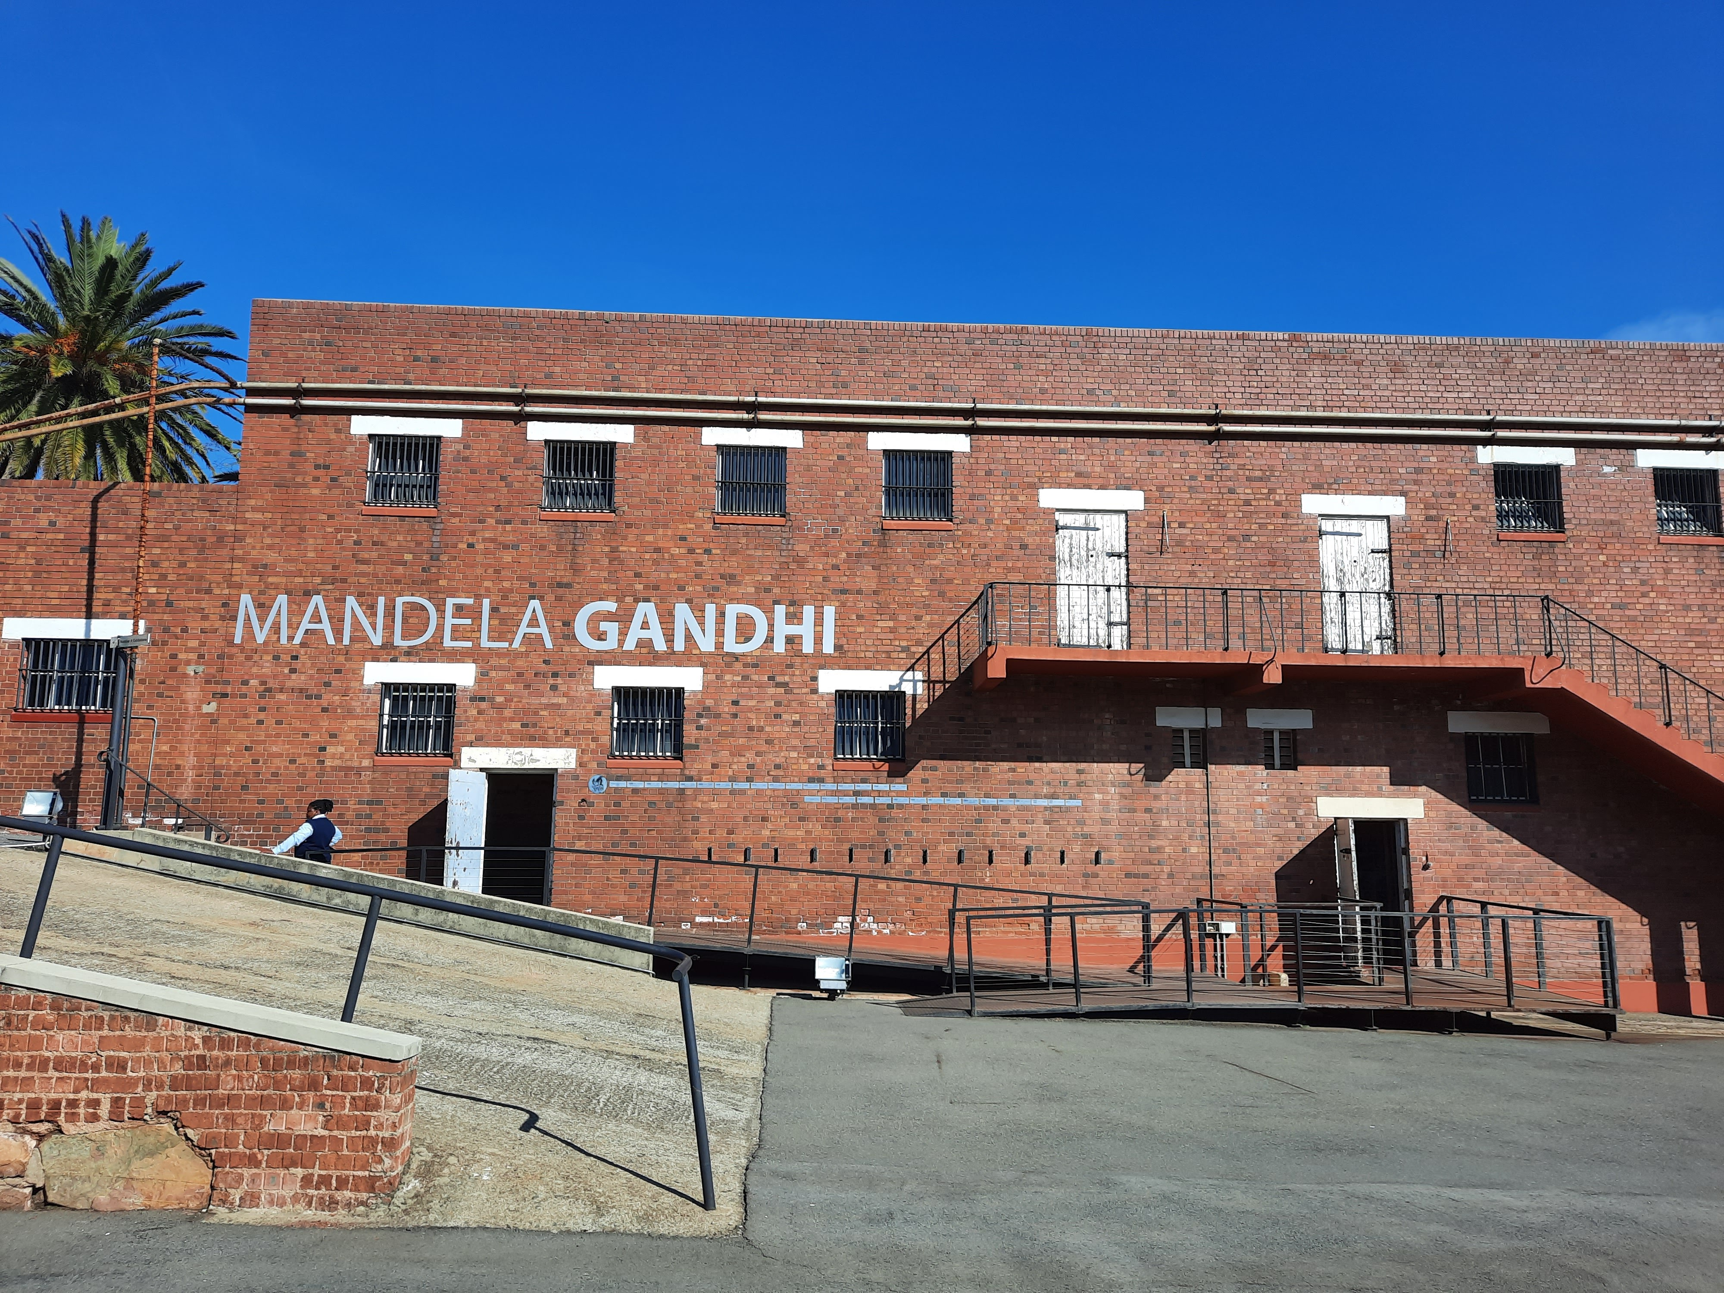
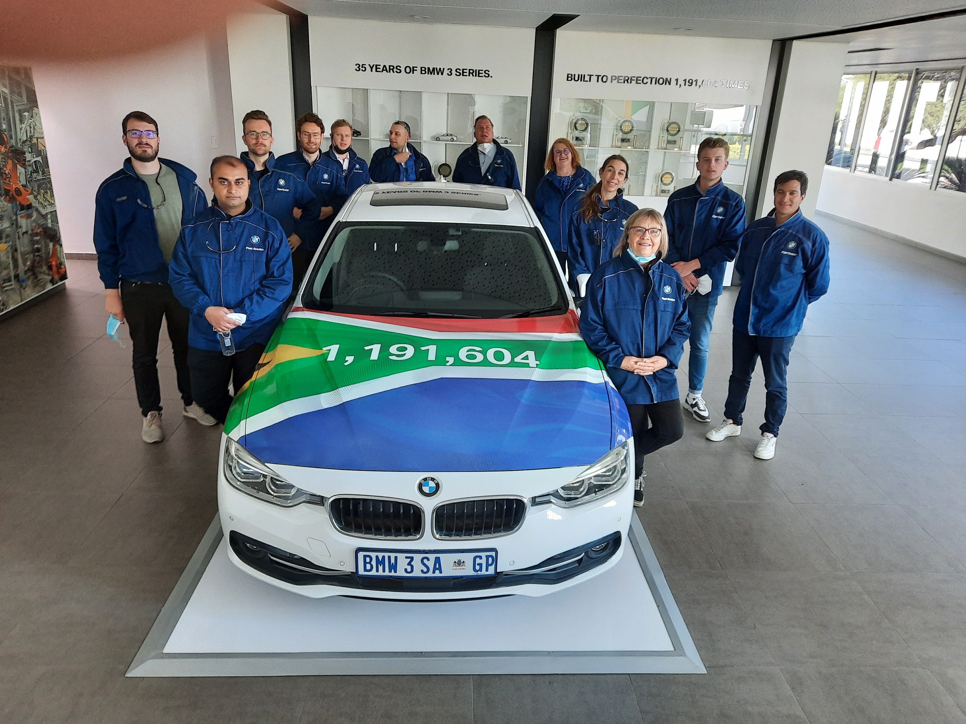
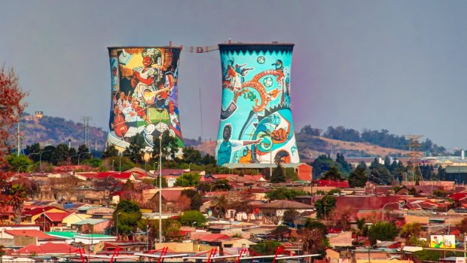
Part-time Master Program M. SC. In Management
Impressions from the International Academy | Capetown and Johannesburg Johannesburg
Notes:
Heike Viellieber

Slide 19
Even more – what is important for you?
Questions & Answers

Slide 20
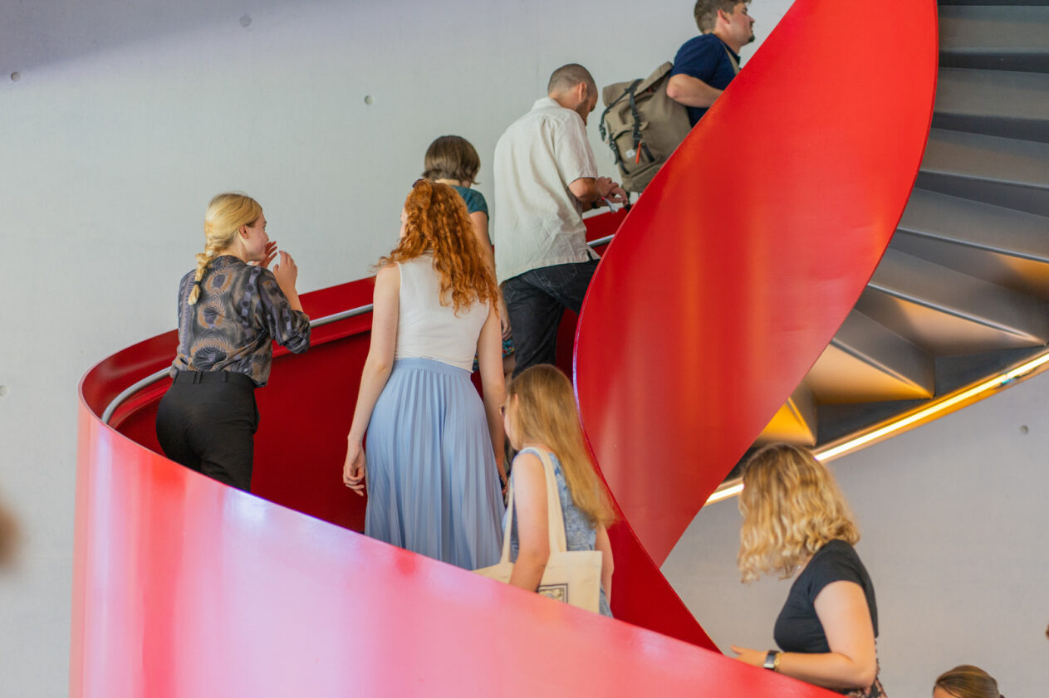
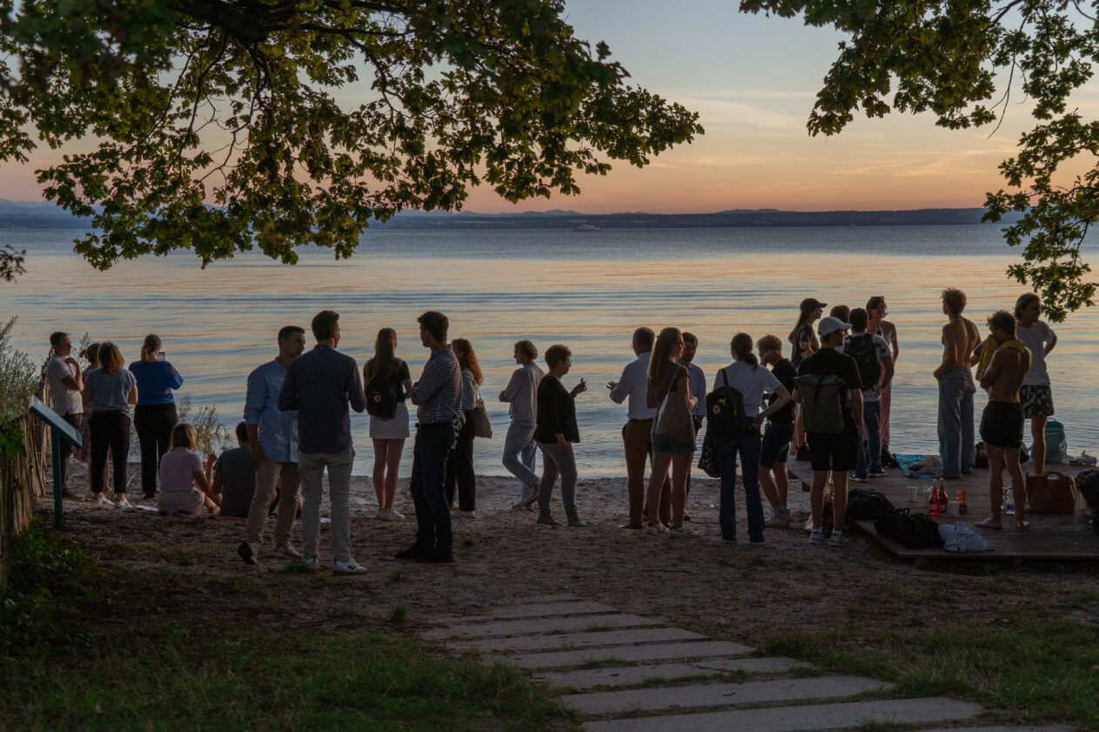

Part-time Master Program M. SC. In Management
Come and join us at the lake!

